Slide 1
Business Data Analysis

Slide 2
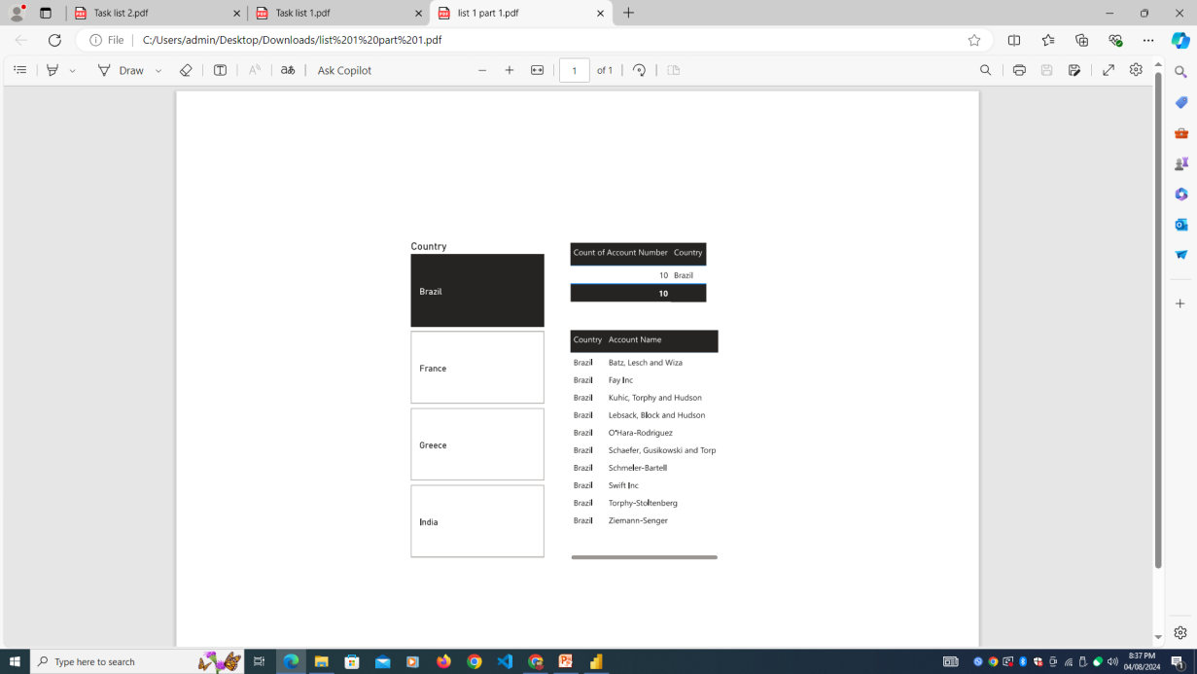
Business Data Analysis in Power BI
Total Count of Account Numbers by Country
This table shows the total count of account numbers grouped by country. It provides a quick overview of how many accounts are associated with each country.
Country-wise Account Holder's Name
This table displays the names of account holders organized by their respective countries. It helps in understanding the distribution of account holders across different countries.
Country-wise Slicer
A country-based slicer has been added to filter the data dynamically. It allows users to select specific countries to focus on, adjusting the visualizations accordingly.
Filtered Data for India, Brazil, Greece, and France The data has been filtered to show only the account information for India, Brazil, Greece, and France. This slide highlights the targeted analysis for these specific countries.
Summary
analysis covered the import and transformation of data, creation of key visualizations, and application of filters to focus on specific countries. The results provide insights into account distribution and ownership by country.

Slide 3
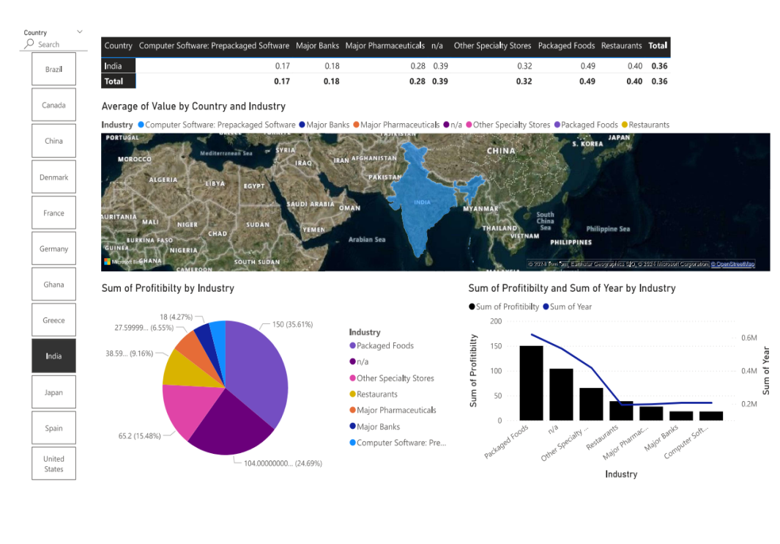
Extended Business Data Analysis in Power BI Further exploration of the Business data file, focusing on industry and profitability metrics across different countries
Country-wise Industry and Average Profitability Margin
This table displays the average profitability margin for each industry by country. It provides insights into how profitable different industries are across various countries.
Country-wise Slicer
A slicer has been added to filter the data based on country selection. This enables dynamic analysis of profitability and industry data for specific countries.
Industry-wise Profitability Percentage (Pie Chart) This pie chart visualizes the profitability percentage for different industries. The data can be viewed for single or multiple countries, providing a comparative analysis.
Profitability Trends by Industry (Line & Stacked Column Chart) The line and stacked column chart shows profitability trends across industries. It highlights how profitability has varied over time and across different industries.
Country-wise Industry Market Values (Map Chart)
The map chart illustrates the market values of industries in different countries. It also shows the presence of various industries geographically, providing a global perspective.
Summary
This extended analysis provides a deeper dive into industry profitability and market presence, offering valuable insights for strategic decision-making.

Slide 4
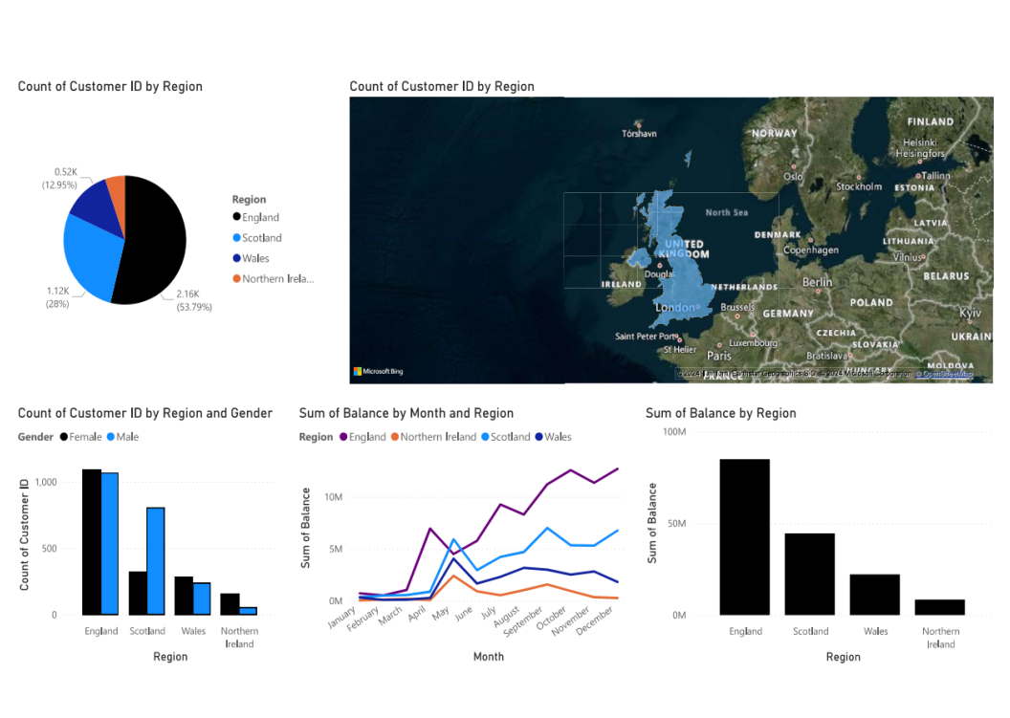
Bank details
Region-wise Number of Customers This visualization shows the number of customers in each region, highlighting areas with the highest and lowest customer bases.
Region-wise Number of Male & Female Customers This chart breaks down the customer base by gender across regions, revealing demographic patterns within each area.
Customer Presence Throughout the World A map displaying the global distribution of customers by region, providing a visual overview of where customers are concentrated.
Region-wise Customer’s Bank Balance This visualization presents the total or average bank balance of customers in each region, offering insights into regional financial health.
Region-wise Monthly Balance Availability Trend A line or area chart showing trends in bank balance availability over time by region, helping to track monthly fluctuations in customer balances.

Slide 5
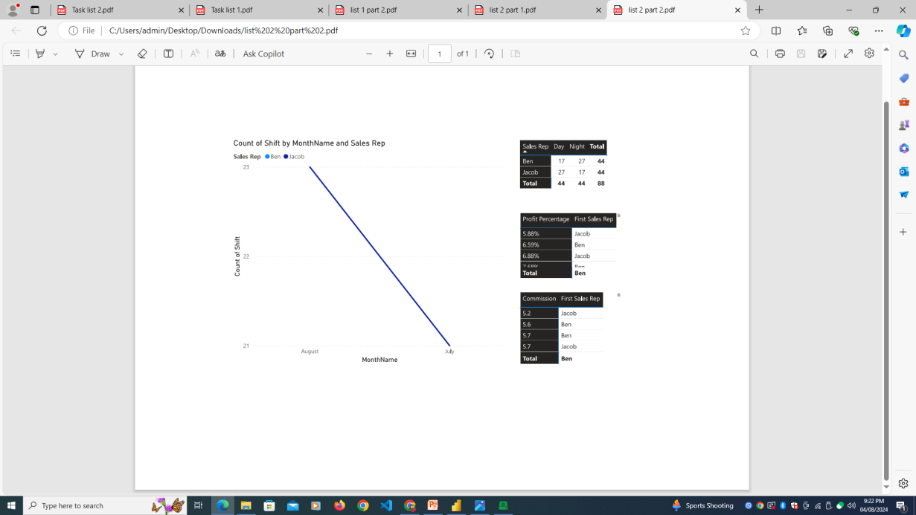
Sales Data
Profit Percentage and Commission by Sales Representative This visualization displays the overall profit percentage and the commission earned by each sales representative, providing insights into individual sales performance.
Total Number of Work Shifts by Sales Representative This chart shows the total number of work shifts completed by each sales representative on a monthly basis, offering an overview of their work patterns.
Day & Night Work Shifts Trends This trend chart illustrates the distribution of day and night shifts across sales representatives, helping to identify patterns in work scheduling.

Slide 6
Action Items for Sales Data Analysis
What are the areas for further improvement in terms of business product sales and profit percentage?
The analysis reveals disparities in profit percentages and commission earnings among sales representatives. This suggests a need for standardizing sales strategies to minimize these differences. Additionally, product sales are underperforming in specific regions, indicating a need for targeted marketing and sales efforts to boost performance.
In which work shift do sales representatives mostly work?
The analysis shows that sales representatives primarily work during a specific shift. Both Ben and Jacob have worked a similar number of shifts, but they differ in the distribution of day and night shifts. This indicates a potential area for optimizing shift schedules to ensure better coverage and efficiency during peak sales hours.
Is there any additional impact identified in terms of product sales trends?
The analysis highlights certain trends in product sales that may be influenced by regional preferences or market conditions. To address low sales in specific countries, there is a need for a deeper regional analysis to tailor product offerings and marketing strategies more effectively to local demands.
What further actions are recommended based on the analysis?
It is recommended to conduct a detailed regional analysis of sales trends and shift patterns. By understanding the specific needs of underperforming regions and optimizing shift schedules, businesses can implement more effective sales strategies and improve overall profit margins.

Slide 7
Thank You

